Slide 2
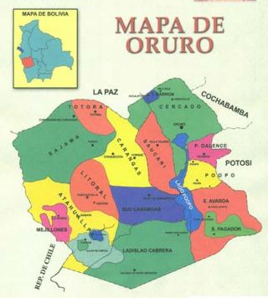
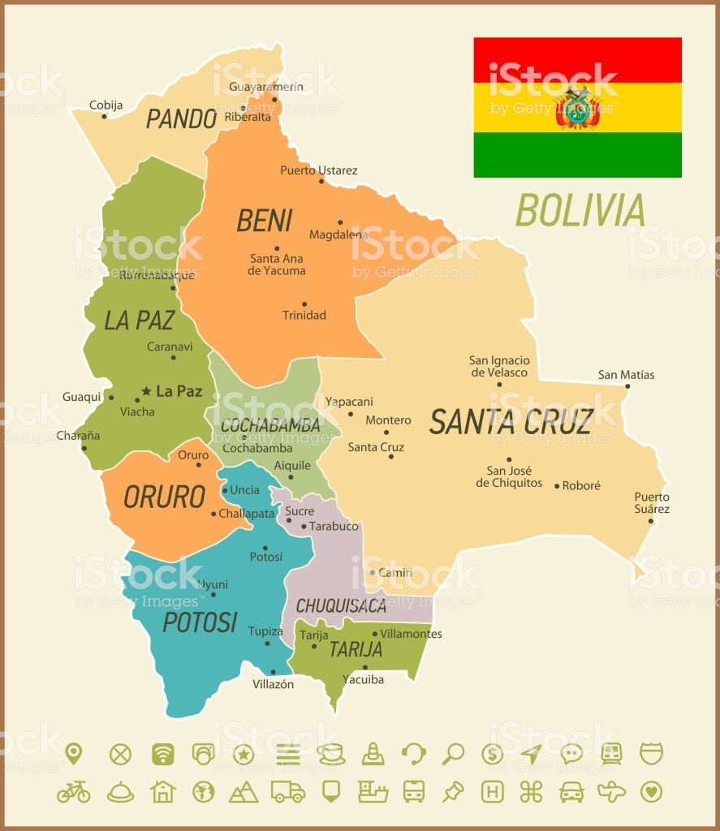
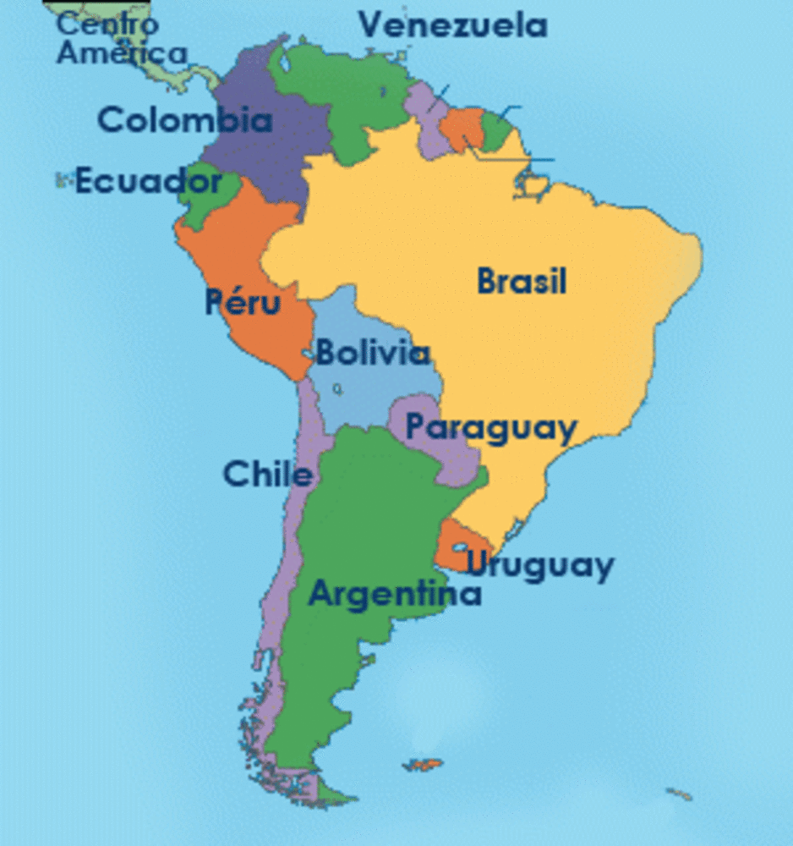
LOCATION
South America
Oruro
Bolivia

Slide 3
DATE
11th - 21st of February in 2023, being 18, 19, 20 and 21 of February the most important days of celebrations.
Oruro Carnival lasts ten days.

Slide 4
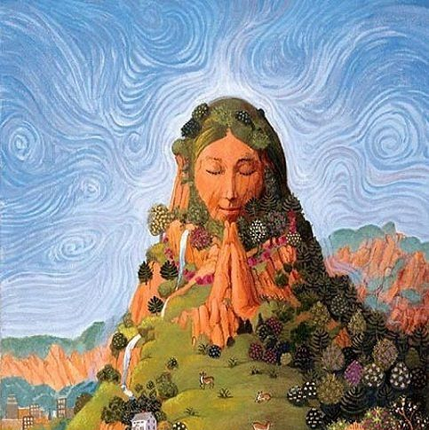
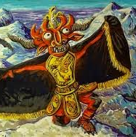
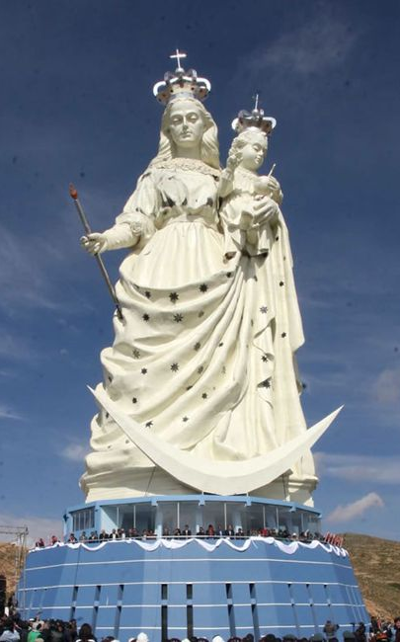
ORIGEN
El origen es una antigua creencia que cuenta que, en aquel tiempo, una virgen había ayudado a un ombre herido a volver a casa, cerca de las minas de plata de Oruro. Desde entonces, la ciudad se ha convertido en un símbolo de protección para los mineros bolivianos.
Principal evento → Diablada: representación de la batalla entre el bien y el mal, en la que el arcángel San Miguel lucha contra una serie de figuras malignas.

Slide 5
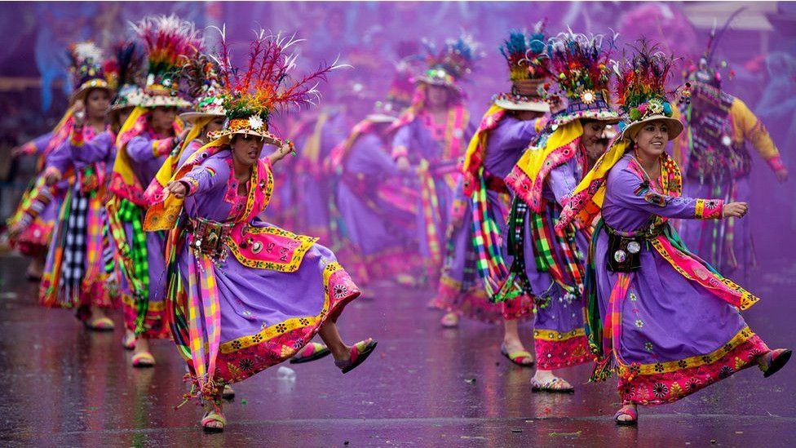
CÓMO SE CELEBRA EN LA ACTUALIDAD
En el desfile de Carnaval participan decenas de agrupaciones con miles de bailarines, músicos y artistas que desfilan al compás de danzas típicas como: la diablada, la morenada, los caporales, los suri sicuris, los waka waka, entre otros. El desfile es trasmitido a todo el país por la televisión de Bolivia.
El significado de la “diablada” (una de las danzas más representativas) es una mezcla de tradiciones andinas y católicas. Cuenta con vistosos disfraces y máscaras de diablos tanto para los hombres como para las mujeres. Liderados por el arcángel Gabriel, simbolizan con sus danzas la salida desde el averno rumbo al juicio.
El Carnaval termina con una multitudinaria procesión final donde participan miles de bailarines y músicos durante más de 15 horas.

Slide 6
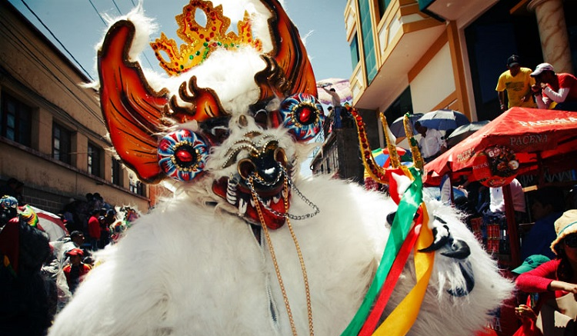
COSTUMES
Carnival sees a blending of Catholic and Indian rituals, mixing the Virgin and Devil teachings of the Catholic religion with the Indian ideas of Pachamama and Tio Supay.
El Tio, the most recognised icon of Carnival, is a malevolent character who transforms into the Devil for Carnival. Known as the Uncle or God of the mountains, indigenous miners believe El Tio is the owner of the mine’s minerals and the overseer of their safety. In the hope he won’t get angry for taking his precious metals, during carnival, miners dance and leave gifts of beer, food, cigarettes and coca for El Tio.
Pachamama is the Earth Mother who the Indigenous people believe is a giving and benevolent goddess much like the Virgin de la Candelaria.
Other notable icons in Carnival include the following:
Archangel San Miguel
Incas
Spanish Conquisadors
Tobas warriors symbolising the victors of the Inca Empire
Caporales represening the overseers who gained a reputation for their cruel treatment of Indian and slave laborers
Morenos representing the Africans who were enslaved by the Spanish back in the 1600s.
Kallawayas representing doctors of the Inca empire

Slide 7
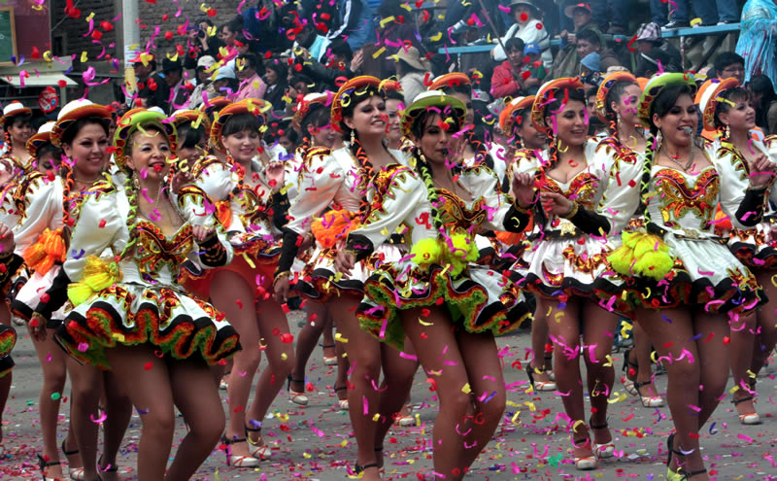
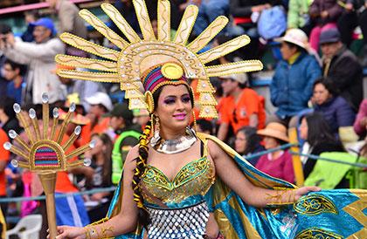
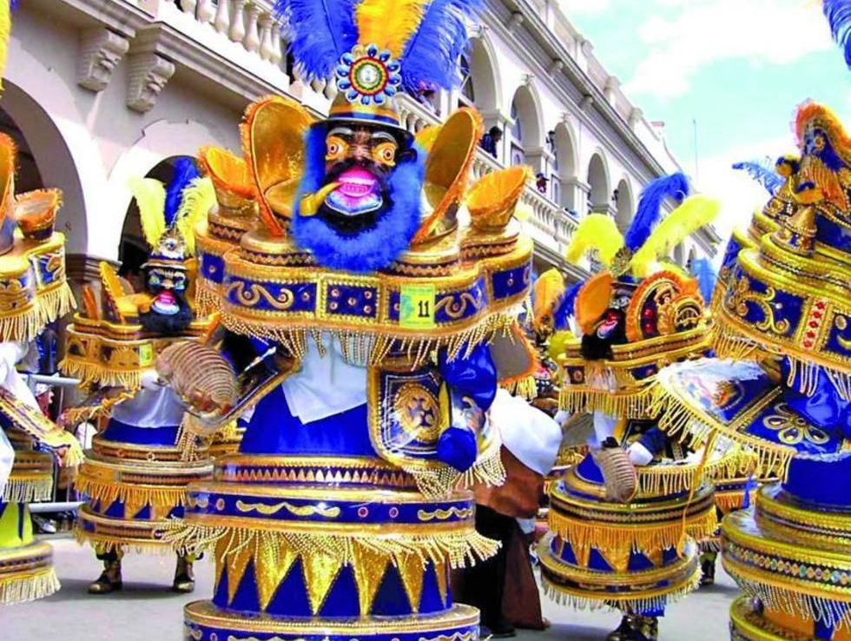
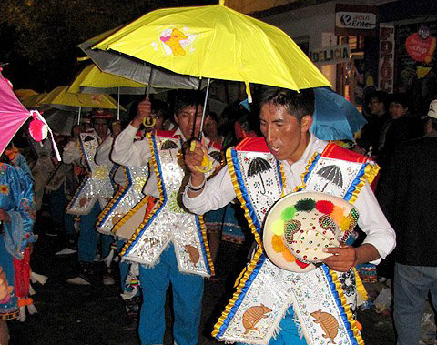
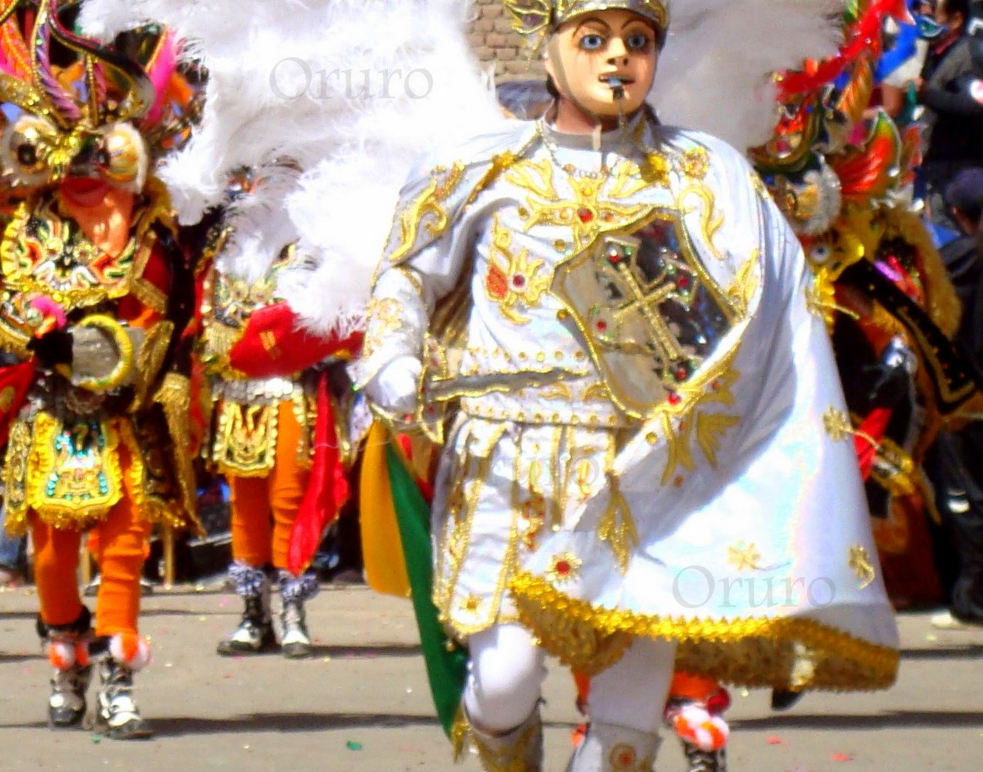

Slide 8
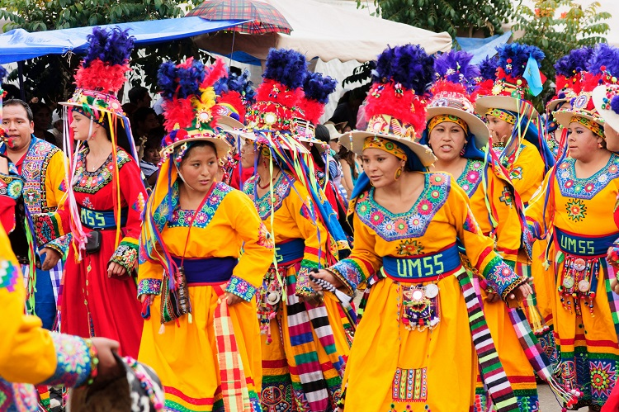
DANCES AND MUSIC
Other dance groups representing various events in Oruro’s history including the Caporales, the Llameradas, the Morenadas, the Tobas, the Phujllay and the Tinkus.
Over 50 folkoric groups made up of around 20,000 dancers participate in the festival representing the various indigenous groups throughout Bolivia.
The most famous of the folk dances is without doubt La Diablada or Dance of the Devils, a ritual representing the victory of good over evil and one that has remained unchanged since colonial times.
Performed for the first time in 1904, La Diablada was born out of the Indigenous miners fear that El Tio, the god of the underworld, would be jealous of the attention they were paying to the Virgin, who was named the patron of Oruro’s Carnival. Since the priests had told the miners that El Tio was in fact the devil, they decided to honor their deity by performing in Carnival as diablos.
Diablada ferroviaria
Carporales San Simon Sucre
Dance of the devil

Slide 9
MORE PICTURES

